Slide 1

Join this livestream…
Hey Class!
join.me/XXX-XX-XXX
© 2016 | RCB - All Rights Reserved
Notes:
7:00 – 7:05

Slide 2
Behold… Bootstrap!
Day 6
Rutgers Coding Bootcamp | February 6, 2016
© 2016 | RCB - All Rights Reserved
Notes:
Start at 6:45 PM

Slide 3
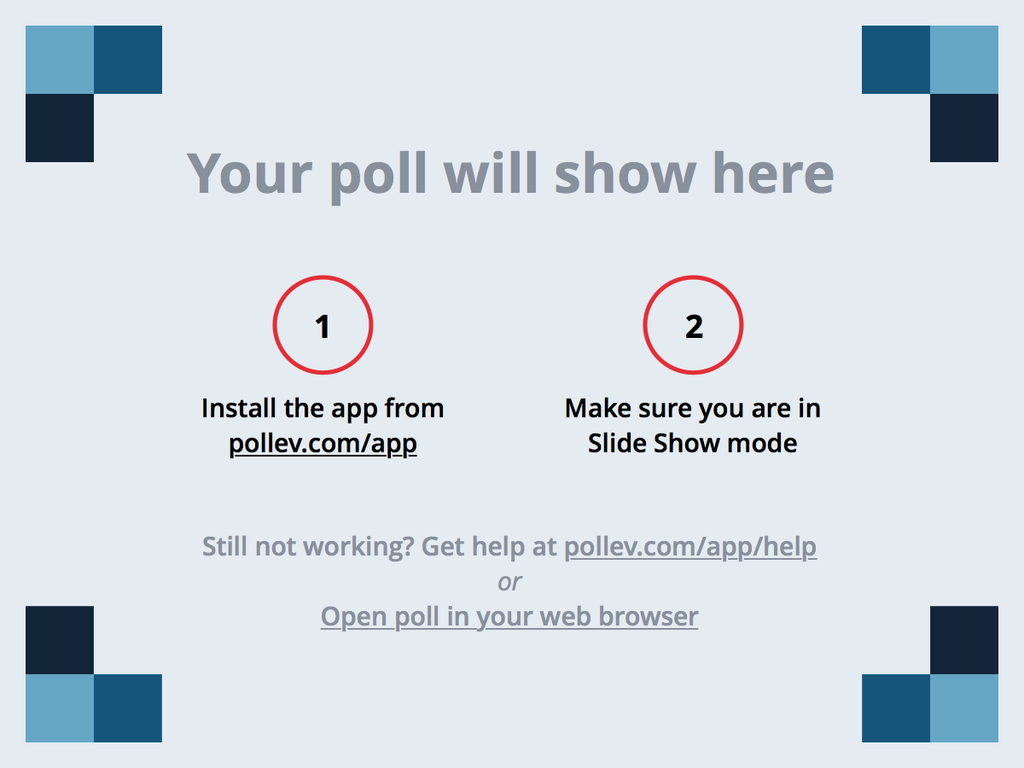
Notes:
Poll Title: In your estimate, how many hours do you think you spent on the last homework assignment? https://www.polleverywhere.com/multiple_choice_polls/V47lscZ0YsFbR3j

Slide 4
Notes:
Poll Title: If you are currently "struggling", what is the biggest challenge right now? https://www.polleverywhere.com/multiple_choice_polls/K4lzuv65imYmKK8

Slide 5
Time for a Check-Up…
© 2016 | RCB - All Rights Reserved
Notes:
7:00 – 7:05

Slide 6
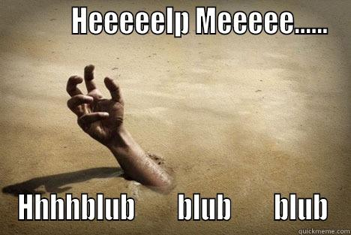

Is this you yet?
© 2016 | RCB - All Rights Reserved
© 2016 | Rutgers Coding Bootcamp - All Rights Reserved

Slide 7
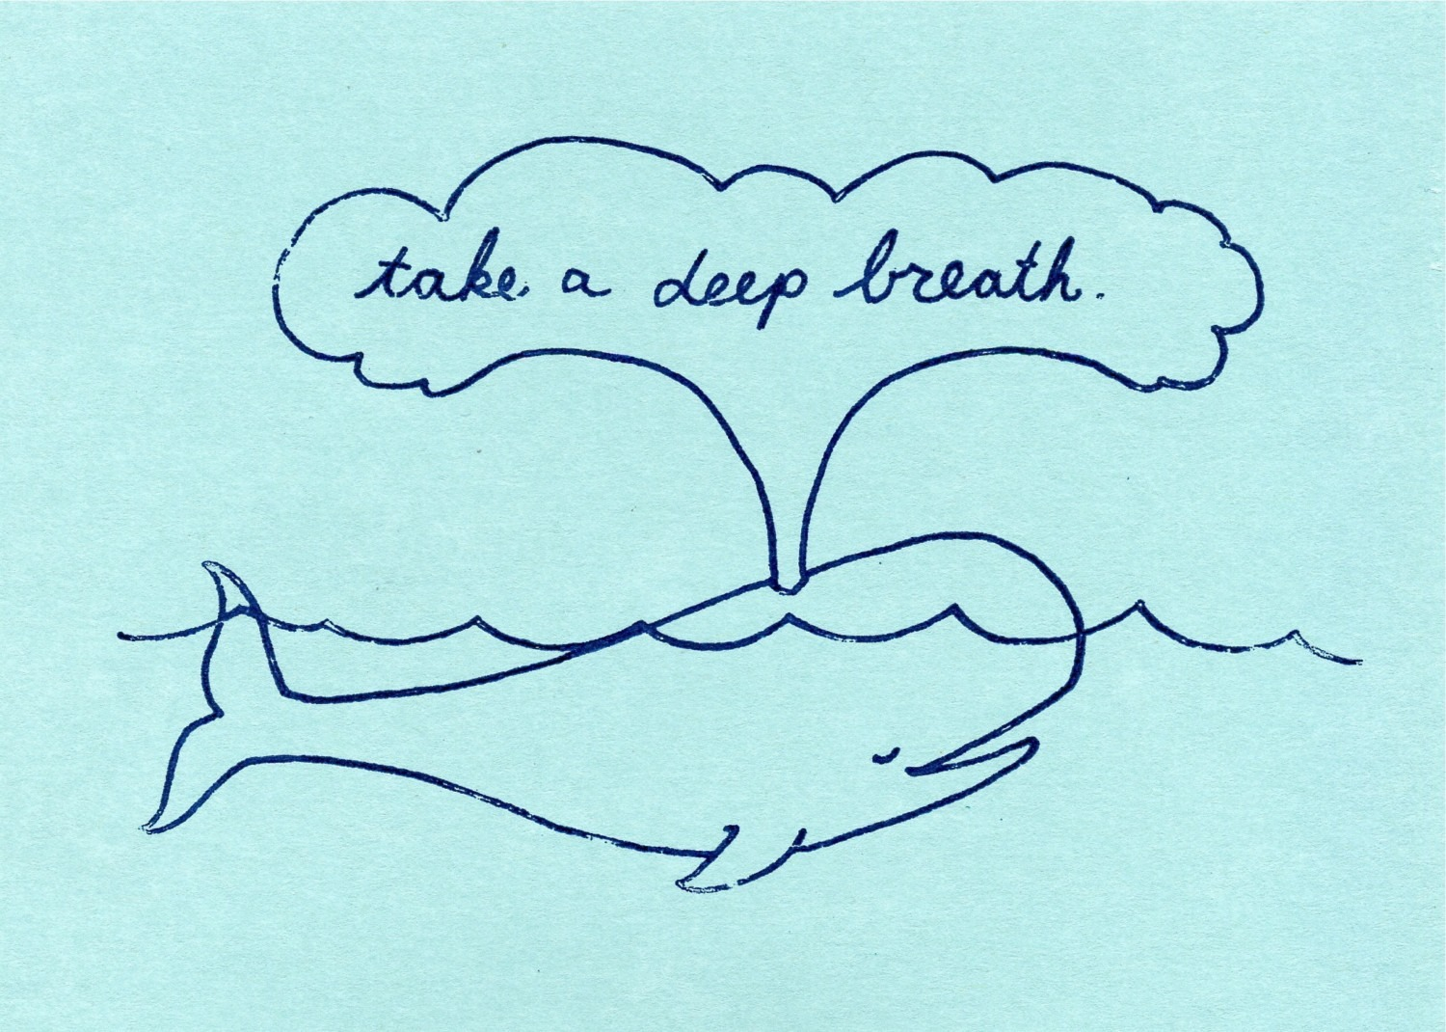
Is this you yet?
© 2016 | RCB - All Rights Reserved
© 2016 | Rutgers Coding Bootcamp - All Rights Reserved

Slide 8

Find Your Checkpoints
© 2016 | RCB - All Rights Reserved
© 2016 | Rutgers Coding Bootcamp - All Rights Reserved

Slide 9

Find Your Checkpoints
© 2016 | RCB - All Rights Reserved
© 2016 | Rutgers Coding Bootcamp - All Rights Reserved

Slide 10
Today’s Class
© 2016 | RCB - All Rights Reserved
Notes:
7:00 – 7:05

Slide 11
Objectives
Students will use Twitter Bootstrap to create layouts
Students will learn to use media queries for mobile responsive websites
Students will learn to use the viewport tag to make sure all devices are displaying web pages optimally
© 2016 | RCB - All Rights Reserved
© 2016 | Rutgers Coding Bootcamp - All Rights Reserved

Slide 12
Recap HTML/CSS
© 2016 | RCB - All Rights Reserved
Notes:
7:00 – 7:05

Slide 13


HTML / CSS Definitions (*yawn* unimportant)
HTML: Hypertext Markup Language – (Content)
CSS: Cascading Style Sheets – (Appearance)
HTML/CSS are the “languages of the web”. Together they define both the content and the aesthetics of a webpage – handling everything from the layouts, colors, fonts, and content placement. (Javascript is the third – handling logic, animation, etc.)
© 2016 | RCB - All Rights Reserved
© 2016 | Rutgers Coding Bootcamp - All Rights Reserved

Slide 14


HTML vs HTML/CSS
HTML Alone
Like writing papers in “Notepad”.
Can only write unformatted text.
HTML / CSS
Like writing papers in Microsoft Word.
Can format text, page settings, alignment, etc. based on “highlighting” and menu options.
© 2016 | RCB - All Rights Reserved
© 2016 | Rutgers Coding Bootcamp - All Rights Reserved

Slide 15
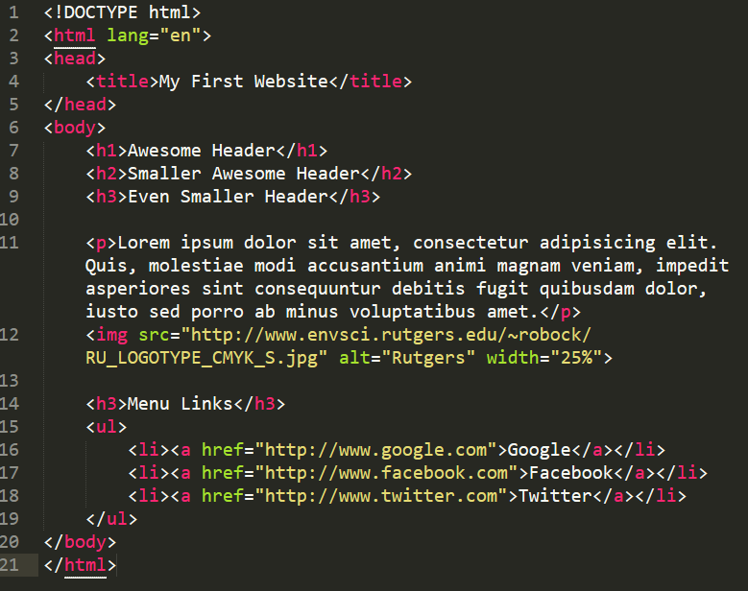
Basic HTML Page
© 2016 | RCB - All Rights Reserved
© 2016 | Rutgers Coding Bootcamp - All Rights Reserved

Slide 16
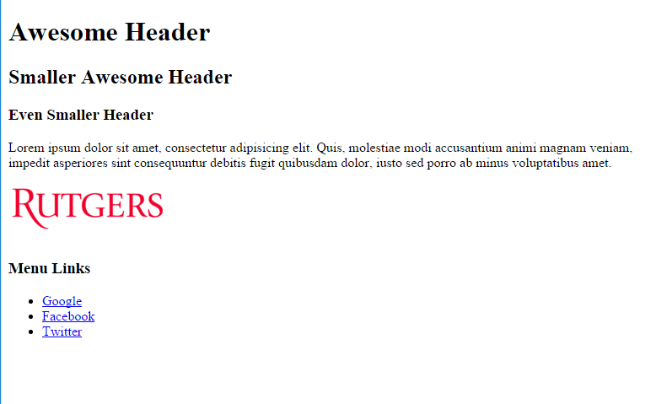
Basic HTML Page
© 2016 | RCB - All Rights Reserved
© 2016 | Rutgers Coding Bootcamp - All Rights Reserved

Slide 17
Basic HTML Page
Hella Boring…
© 2016 | RCB - All Rights Reserved
© 2016 | Rutgers Coding Bootcamp - All Rights Reserved

Slide 18
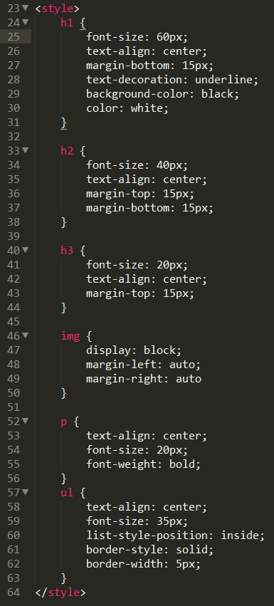
Enter CSS
© 2016 | RCB - All Rights Reserved
© 2016 | Rutgers Coding Bootcamp - All Rights Reserved

Slide 19
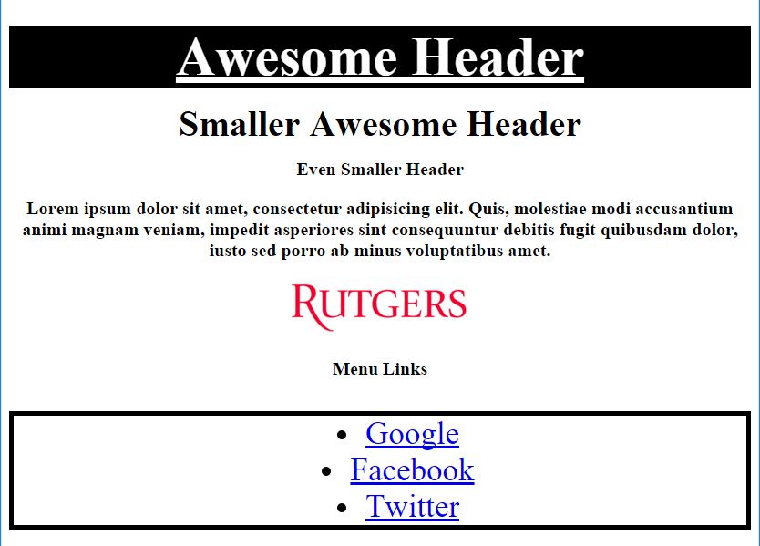
Enter CSS
© 2016 | RCB - All Rights Reserved
© 2016 | Rutgers Coding Bootcamp - All Rights Reserved

Slide 20
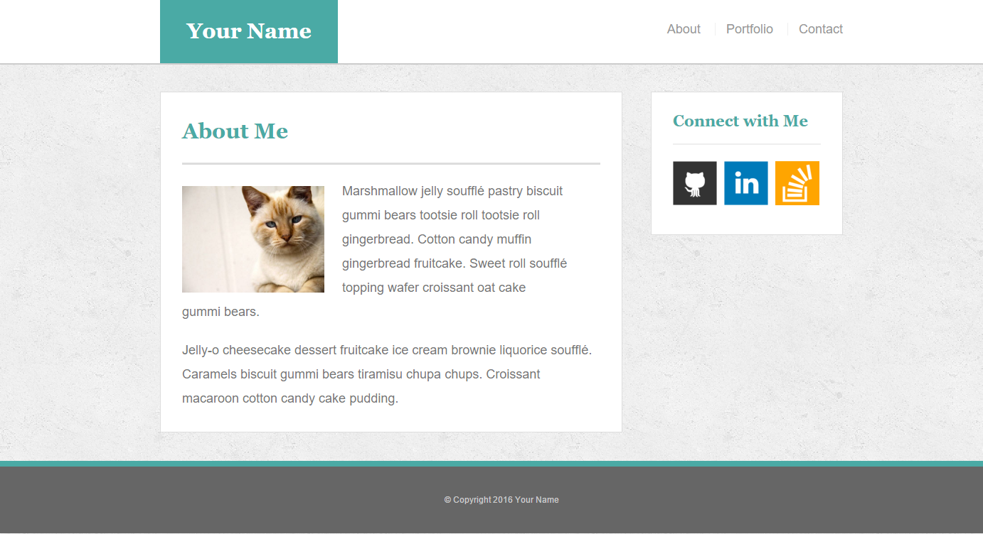
Homework 1 – HTML/CSS
© 2016 | RCB - All Rights Reserved
© 2016 | Rutgers Coding Bootcamp - All Rights Reserved

Slide 21
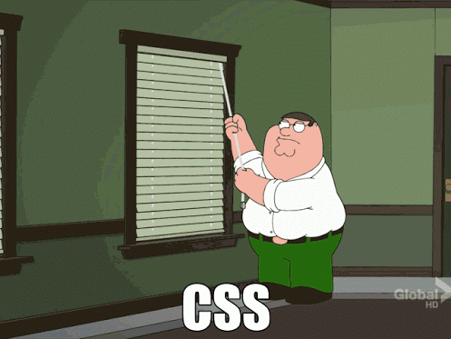
How I Feel About CSS
© 2016 | RCB - All Rights Reserved
© 2016 | Rutgers Coding Bootcamp - All Rights Reserved

Slide 22
Behold! Bootstrap
© 2016 | RCB - All Rights Reserved
Notes:
7:00 – 7:05

Slide 23
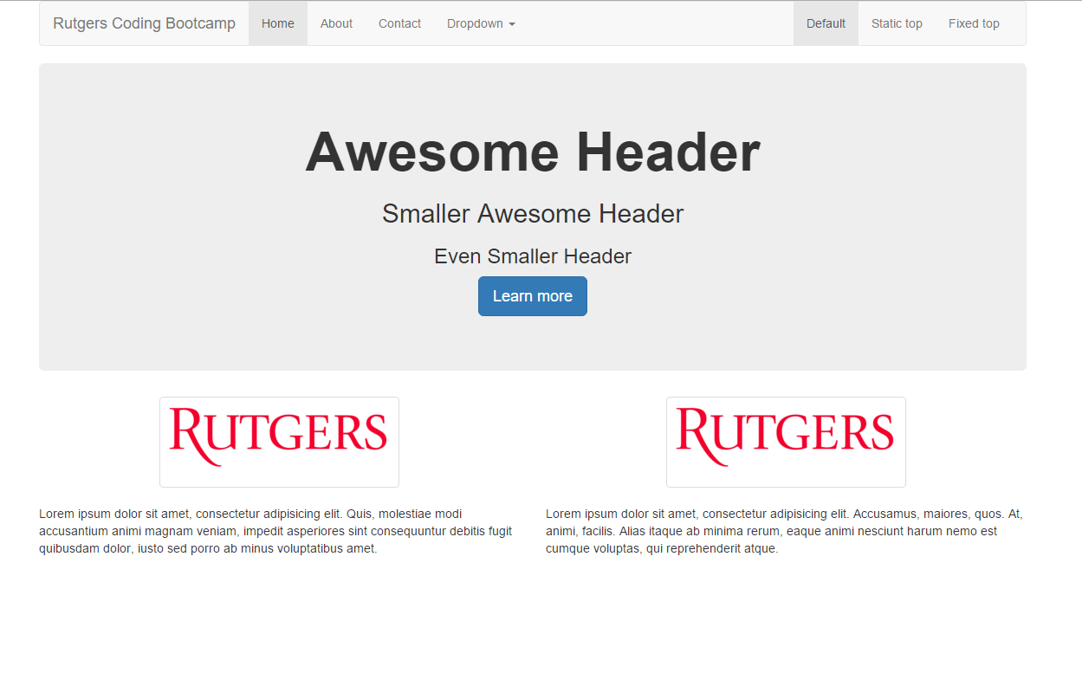
Powered by Bootstrap
© 2016 | RCB - All Rights Reserved
© 2016 | Rutgers Coding Bootcamp - All Rights Reserved

Slide 24
> YOUR TURN!!
5 minutes
Quick Activity:
With those closest to you, take a close look at the Bootstrap-powered HTML document I just sent you.
Then, be prepared to answer the following two questions:
Where is this HTML document drawing its styles from?
How does our browser know which HTML element to style in which way? (ex: image sizing or background banner)
HINT: Think about Google Fonts…
© 2016 | RCB - All Rights Reserved
Notes:
Send snapshot from Git command line

Slide 25

Powered by Bootstrap
External CSS Link
Using an external (web) based style-sheet, Bootstrap comes pre-loaded with a set of CSS classes that can be deployed as necessary.
© 2016 | RCB - All Rights Reserved
© 2016 | Rutgers Coding Bootcamp - All Rights Reserved

Slide 26

Powered by Bootstrap
External CSS Link
Pre-Defined CSS Class (ex: “jumbotron”)
© 2016 | RCB - All Rights Reserved
© 2016 | Rutgers Coding Bootcamp - All Rights Reserved

Slide 27
Powered by Bootstrap
class=“jumbotron”
© 2016 | RCB - All Rights Reserved
© 2016 | Rutgers Coding Bootcamp - All Rights Reserved

Slide 28
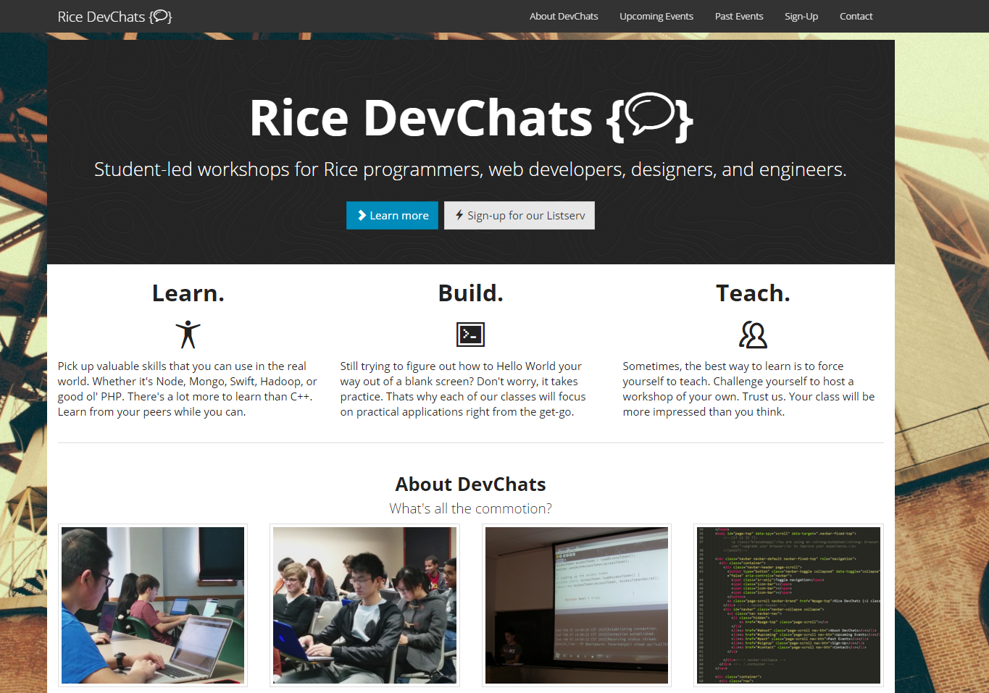
Ahmed’s Sample Site
www.ricedevchats.org
© 2016 | RCB - All Rights Reserved
© 2016 | Rutgers Coding Bootcamp - All Rights Reserved

Slide 29
What’s Bootstrap?
© 2016 | RCB - All Rights Reserved
Notes:
7:00 – 7:05

Slide 30

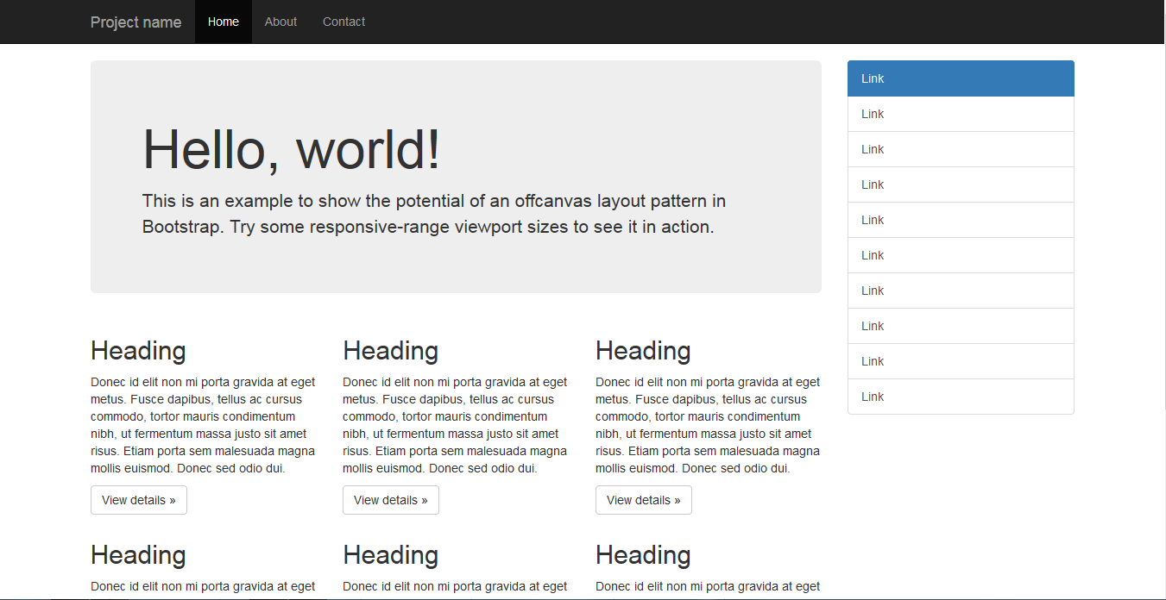
Bootstrap Definition
Twitter Bootstrap is a free collection of tools for creating websites and web applications.
It comes with a pre-built design template for typography, forms, buttons, navigation, UI elements, and javascript.
Documentation here: http://getbootstrap.com/
© 2016 | RCB - All Rights Reserved
© 2016 | Rutgers Coding Bootcamp - All Rights Reserved

Slide 31

Why Use Bootstrap?
Reason #1: UI Kit
Familiarize yourself with the UI features it offers via the documentation.
Once Bootstrap is active, you can simply copy snippets from the documentation to save yourself major time of creating elements yourself.
© 2016 | RCB - All Rights Reserved
© 2016 | Rutgers Coding Bootcamp - All Rights Reserved

Slide 32

Why Use Bootstrap?
Reason #2: Mobile Responsiveness
One of the most compelling reasons to use Bootstrap is the default mobile-responsive quality it provides.
This means that your website will look “good” automatically when viewed on screens ranging from monitors to tablets to phones. Visit www.ricedevchats.org for an example.
© 2016 | RCB - All Rights Reserved
© 2016 | Rutgers Coding Bootcamp - All Rights Reserved

Slide 33
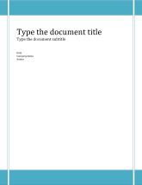
HTML / CSS / Bootstrap Analogy
HTML Alone
Like writing papers in “Notepad”.
Can only write unformatted text.
HTML / CSS
Like writing papers in Microsoft Word.
Can format text, page settings, alignment, etc. based on “highlighting” and menu options.
HTML / CSS & Bootstrap
Like writing papers in Microsoft Word with a prebuilt template.
You can still customize, but now have a pre-built style and aesthetic look.
© 2016 | RCB - All Rights Reserved
© 2016 | Rutgers Coding Bootcamp - All Rights Reserved

Slide 34
Key Bootstrap Parts
© 2016 | RCB - All Rights Reserved
Notes:
7:00 – 7:05

Slide 35
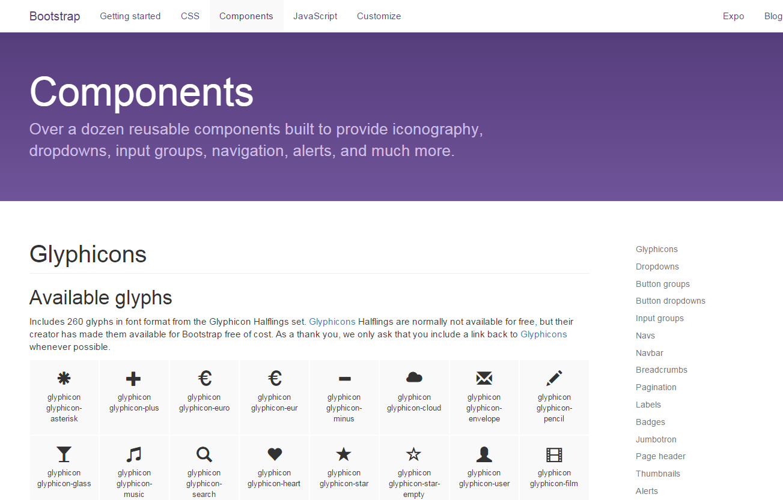
Bootstrap Components
Bootstrap offers a wide range of components for inclusion in your next web project. Best way to use them is to simply flip through the documentation and incorporate elements as necessary.
© 2016 | RCB - All Rights Reserved
© 2016 | Rutgers Coding Bootcamp - All Rights Reserved

Slide 36

Bootstrap Nav Bars
© 2016 | RCB - All Rights Reserved
© 2016 | Rutgers Coding Bootcamp - All Rights Reserved

Slide 37
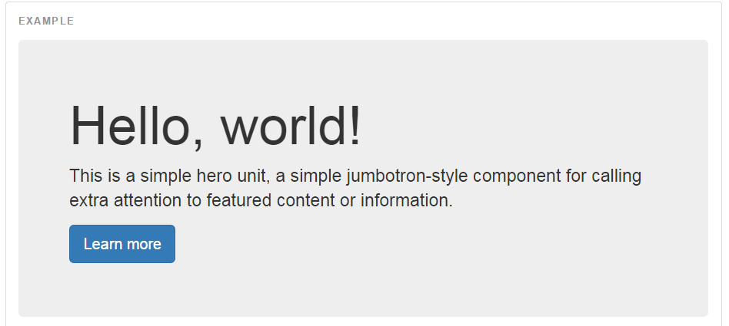

Bootstrap Jumbotron
© 2016 | RCB - All Rights Reserved
© 2016 | Rutgers Coding Bootcamp - All Rights Reserved

Slide 38
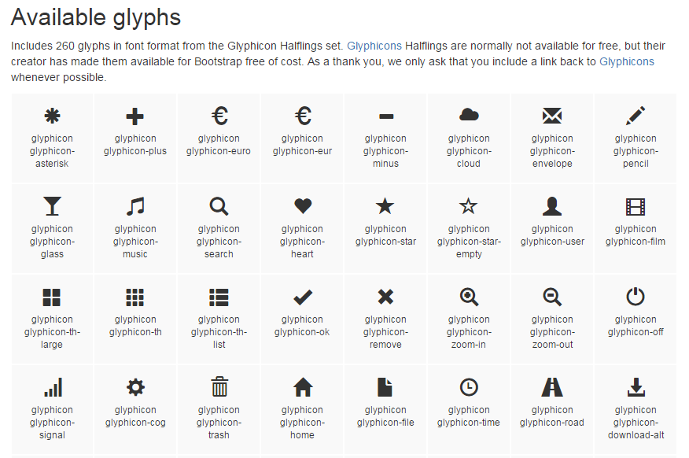
Bootstrap Glyphs
Example:
<span class="glyphicon glyphicon-certificate"></span>
© 2016 | RCB - All Rights Reserved
© 2016 | Rutgers Coding Bootcamp - All Rights Reserved

Slide 39

Bootstrap Table
Example:
<table class="table table-striped">
<tr>
<th>First Name</th>
<th>Last Name</th>
<th>Username</th>
</tr>
<tr>
<td>Mark</td>
<td>Otto</td>
</td>@mdo</td>
</tr>
…
</table>
© 2016 | RCB - All Rights Reserved
© 2016 | Rutgers Coding Bootcamp - All Rights Reserved

Slide 40


Bootstrap Form
© 2016 | RCB - All Rights Reserved
© 2016 | Rutgers Coding Bootcamp - All Rights Reserved

Slide 41
Bootstrap Show
© 2016 | RCB - All Rights Reserved
Notes:
7:00 – 7:05

Slide 42
> YOUR TURN!!
10 min
Quick Activity:
Working with someone closest to you:
Navigate to the Twitter Bootstrap website.
Then copy the link to the Bootstrap CSS file into one of your old HTML files.
Look through the Bootstrap CSS or Components list and incorporate at least one Bootstrap element into your page.
Slack a screenshot of your page to your section’s channel when you are done.
© 2016 | RCB - All Rights Reserved
Notes:
Send snapshot from Git command line

Slide 43
Sketching / Grid Layouts
© 2016 | RCB - All Rights Reserved
Notes:
7:00 – 7:05

Slide 44

Take a Huge Breath…
© 2016 | RCB - All Rights Reserved
Notes:
7:00 – 7:05

Slide 45

FOCUS!
Because in my opinion, these next two sections are the
MOST IMPORTANT ONES
in the ENTIRE program.
Facebook prowl at your own peril.
© 2016 | RCB - All Rights Reserved
Notes:
7:00 – 7:05

Slide 46
FOCUS!
Relax. That doesn’t mean its hard.
© 2016 | RCB - All Rights Reserved
© 2016 | Rutgers Coding Bootcamp - All Rights Reserved

Slide 47
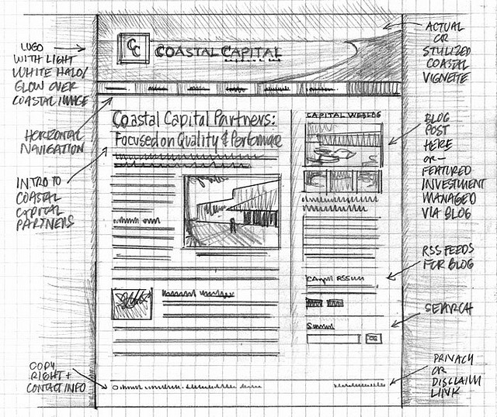
Importance of Sketches
Because every aspect of a site’s “look” is defined by HTML/CSS – it is crucial to have a detailed sketch going in.
Pay particular attention to the location of navigation bars, titles, headers, content, images, footers etc.
When imagining alignments, in particular, be mindful of the grid
© 2016 | RCB - All Rights Reserved
© 2016 | Rutgers Coding Bootcamp - All Rights Reserved

Slide 48
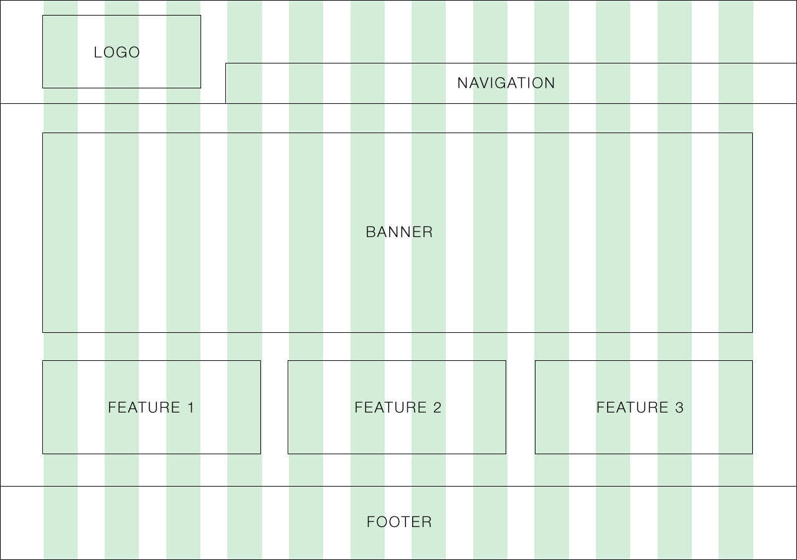
Designing with a Grid in Mind
Grids serve to align elements aesthetically.
© 2016 | RCB - All Rights Reserved
© 2016 | Rutgers Coding Bootcamp - All Rights Reserved

Slide 49

Facebook’s Grid
Facebook is a perfect example of a website where the “grid-layout” is obvious.
Grids make it easy to have content (text, images, and regions) align aesthetically.
© 2016 | RCB - All Rights Reserved
© 2016 | Rutgers Coding Bootcamp - All Rights Reserved

Slide 50
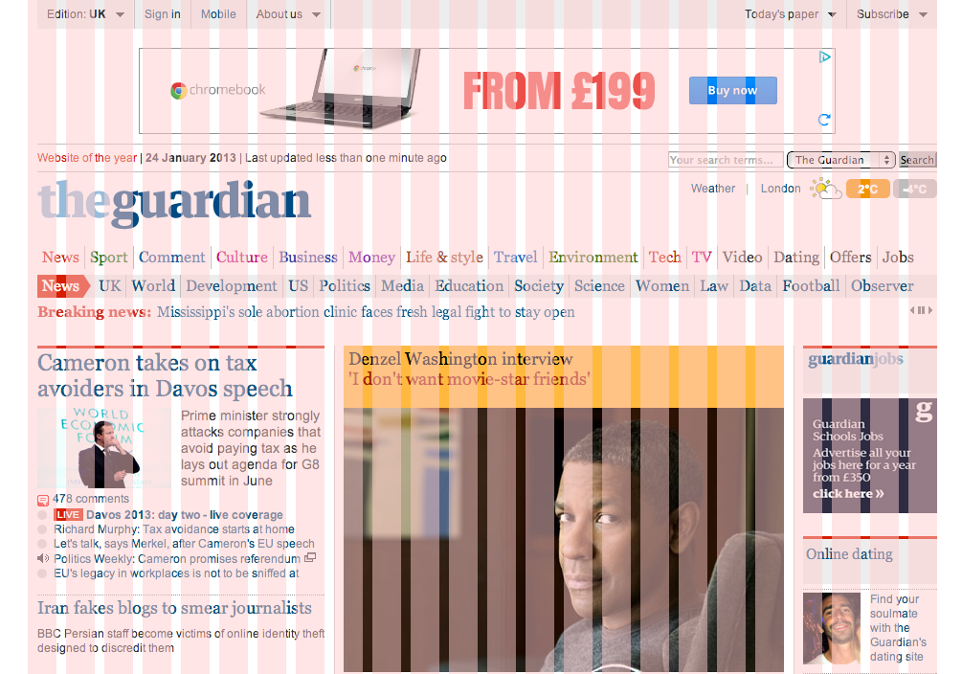
A More Complex Grid…
© 2016 | RCB - All Rights Reserved
© 2016 | Rutgers Coding Bootcamp - All Rights Reserved

Slide 51
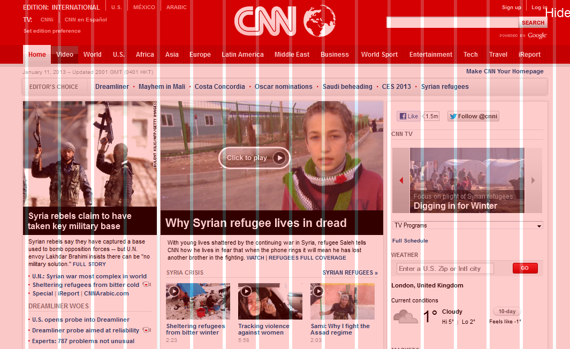
A More Complex Grid…
© 2016 | RCB - All Rights Reserved
© 2016 | Rutgers Coding Bootcamp - All Rights Reserved

Slide 52
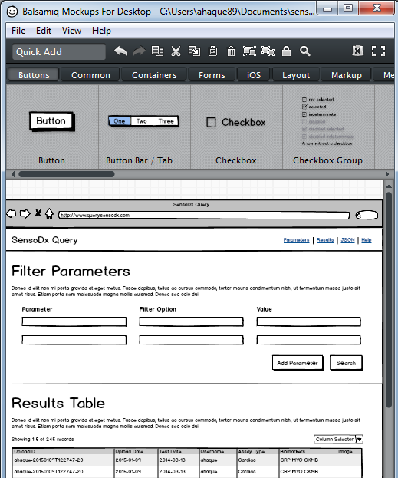
Tools for Sketch / Grid Creation
Wireframing Tools:
Balsamiq***: https://balsamiq.com/
Framebox: http://framebox.org/
Pen and Paper: Your notebook
Grids for Photoshop / Illustrator:
960 GS: http://960.gs/
GuideGuide: http://framebox.org/
Designing with Grids Guides:
960 Grid System Made Easy: http://bit.ly/1sjYaFC
Design by Grid: http://www.designbygrid.com/
Designing with Grid-Based Approach: http://bit.ly/1CM4Hzo
© 2016 | RCB - All Rights Reserved
© 2016 | Rutgers Coding Bootcamp - All Rights Reserved

Slide 53
Rows and Columns
Workshop
© 2016 | RCB - All Rights Reserved
Notes:
7:00 – 7:05

Slide 54
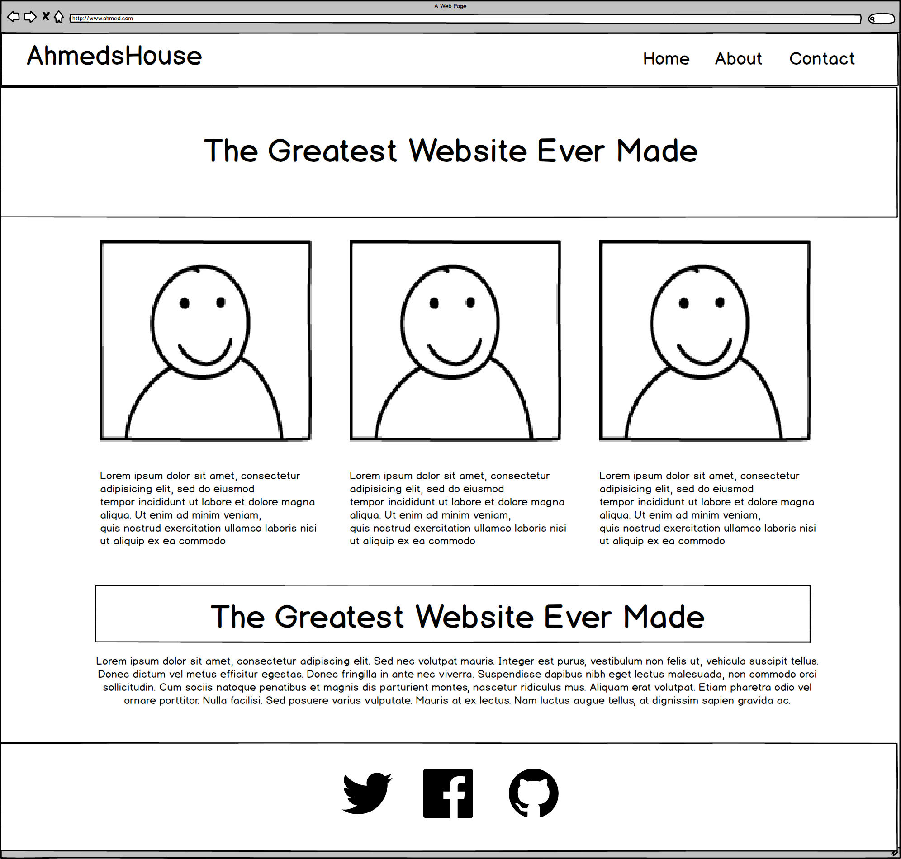
Web Design Fundamentally = Wireframes
© 2016 | RCB - All Rights Reserved
Notes:
7:00 – 7:05

Slide 55
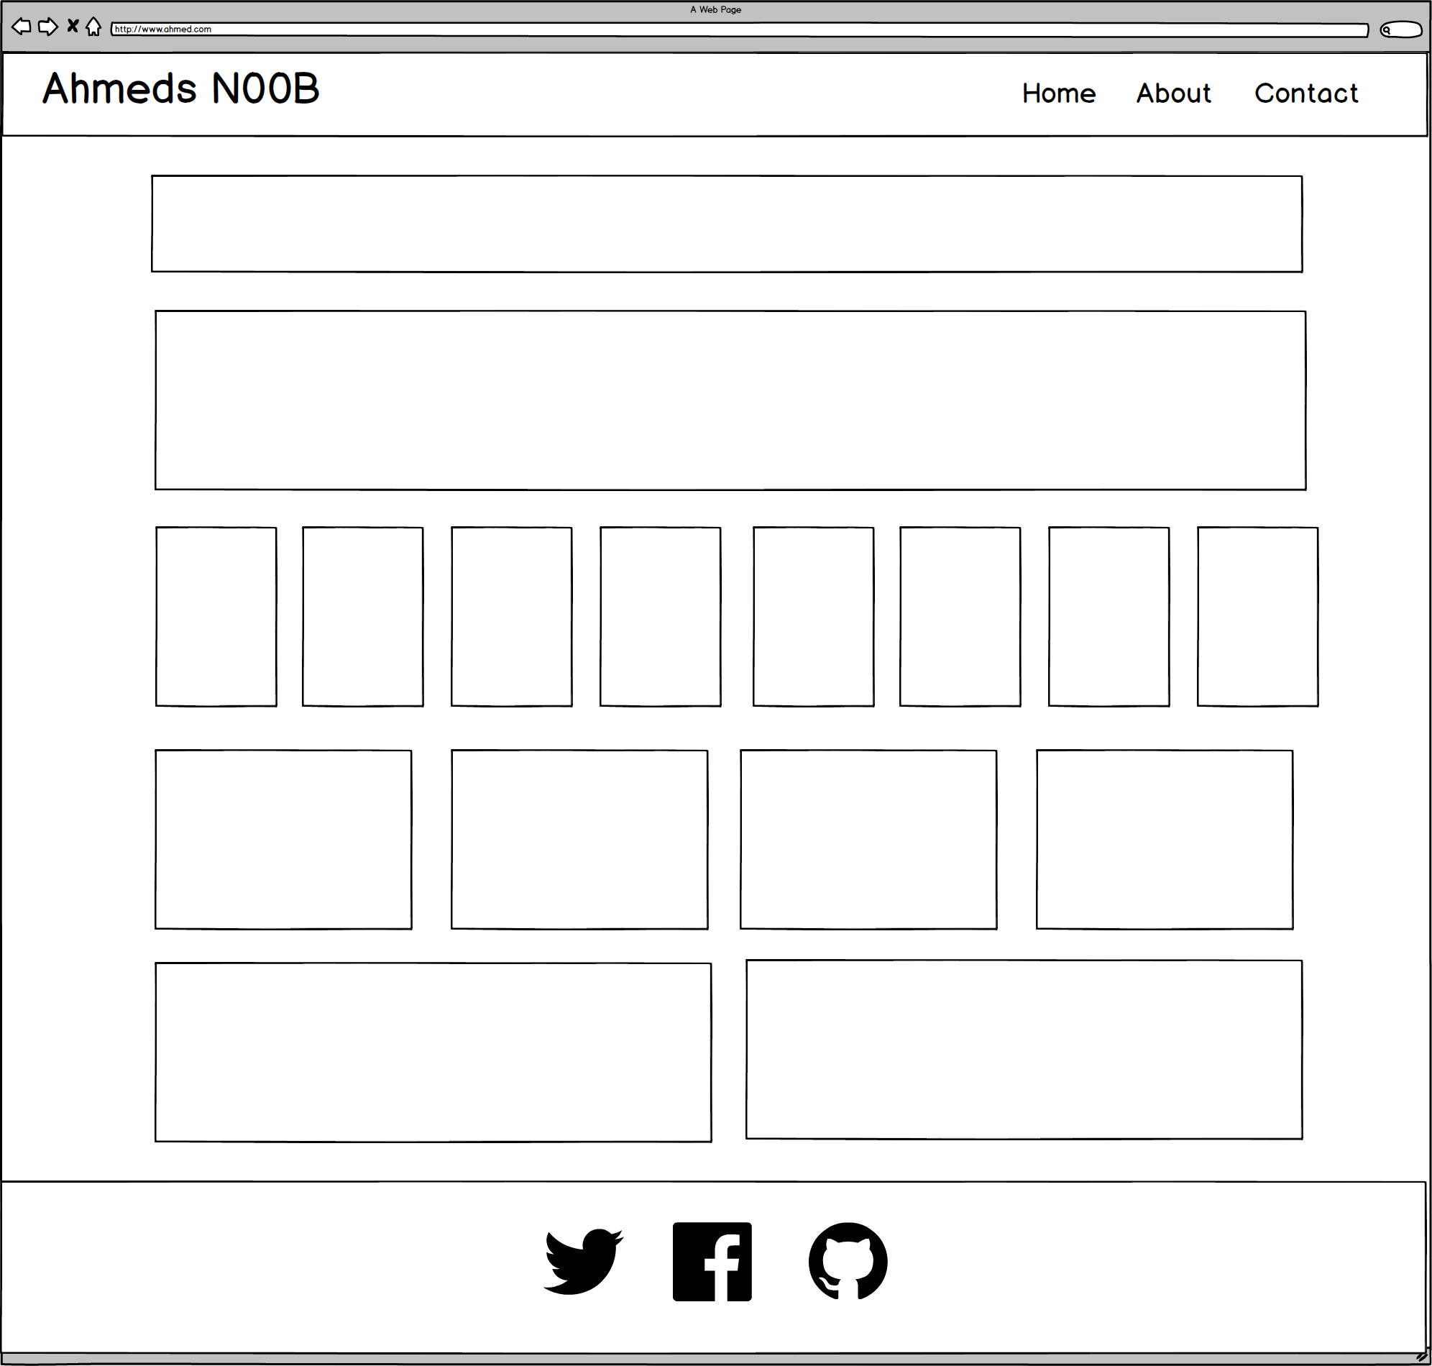
Notes:
7:00 – 7:05

Slide 56
ROWS
1
1
1
1
1
6 Total
1
Notes:
7:00 – 7:05

Slide 57
COLUMNS
1
1
8
4
2
1
Total Not relevant
Notes:
7:00 – 7:05

Slide 58
Notes:
7:00 – 7:05

Slide 59
Level Up
Now, let’s make it more challenging…
© 2016 | RCB - All Rights Reserved
© 2016 | Rutgers Coding Bootcamp - All Rights Reserved

Slide 60
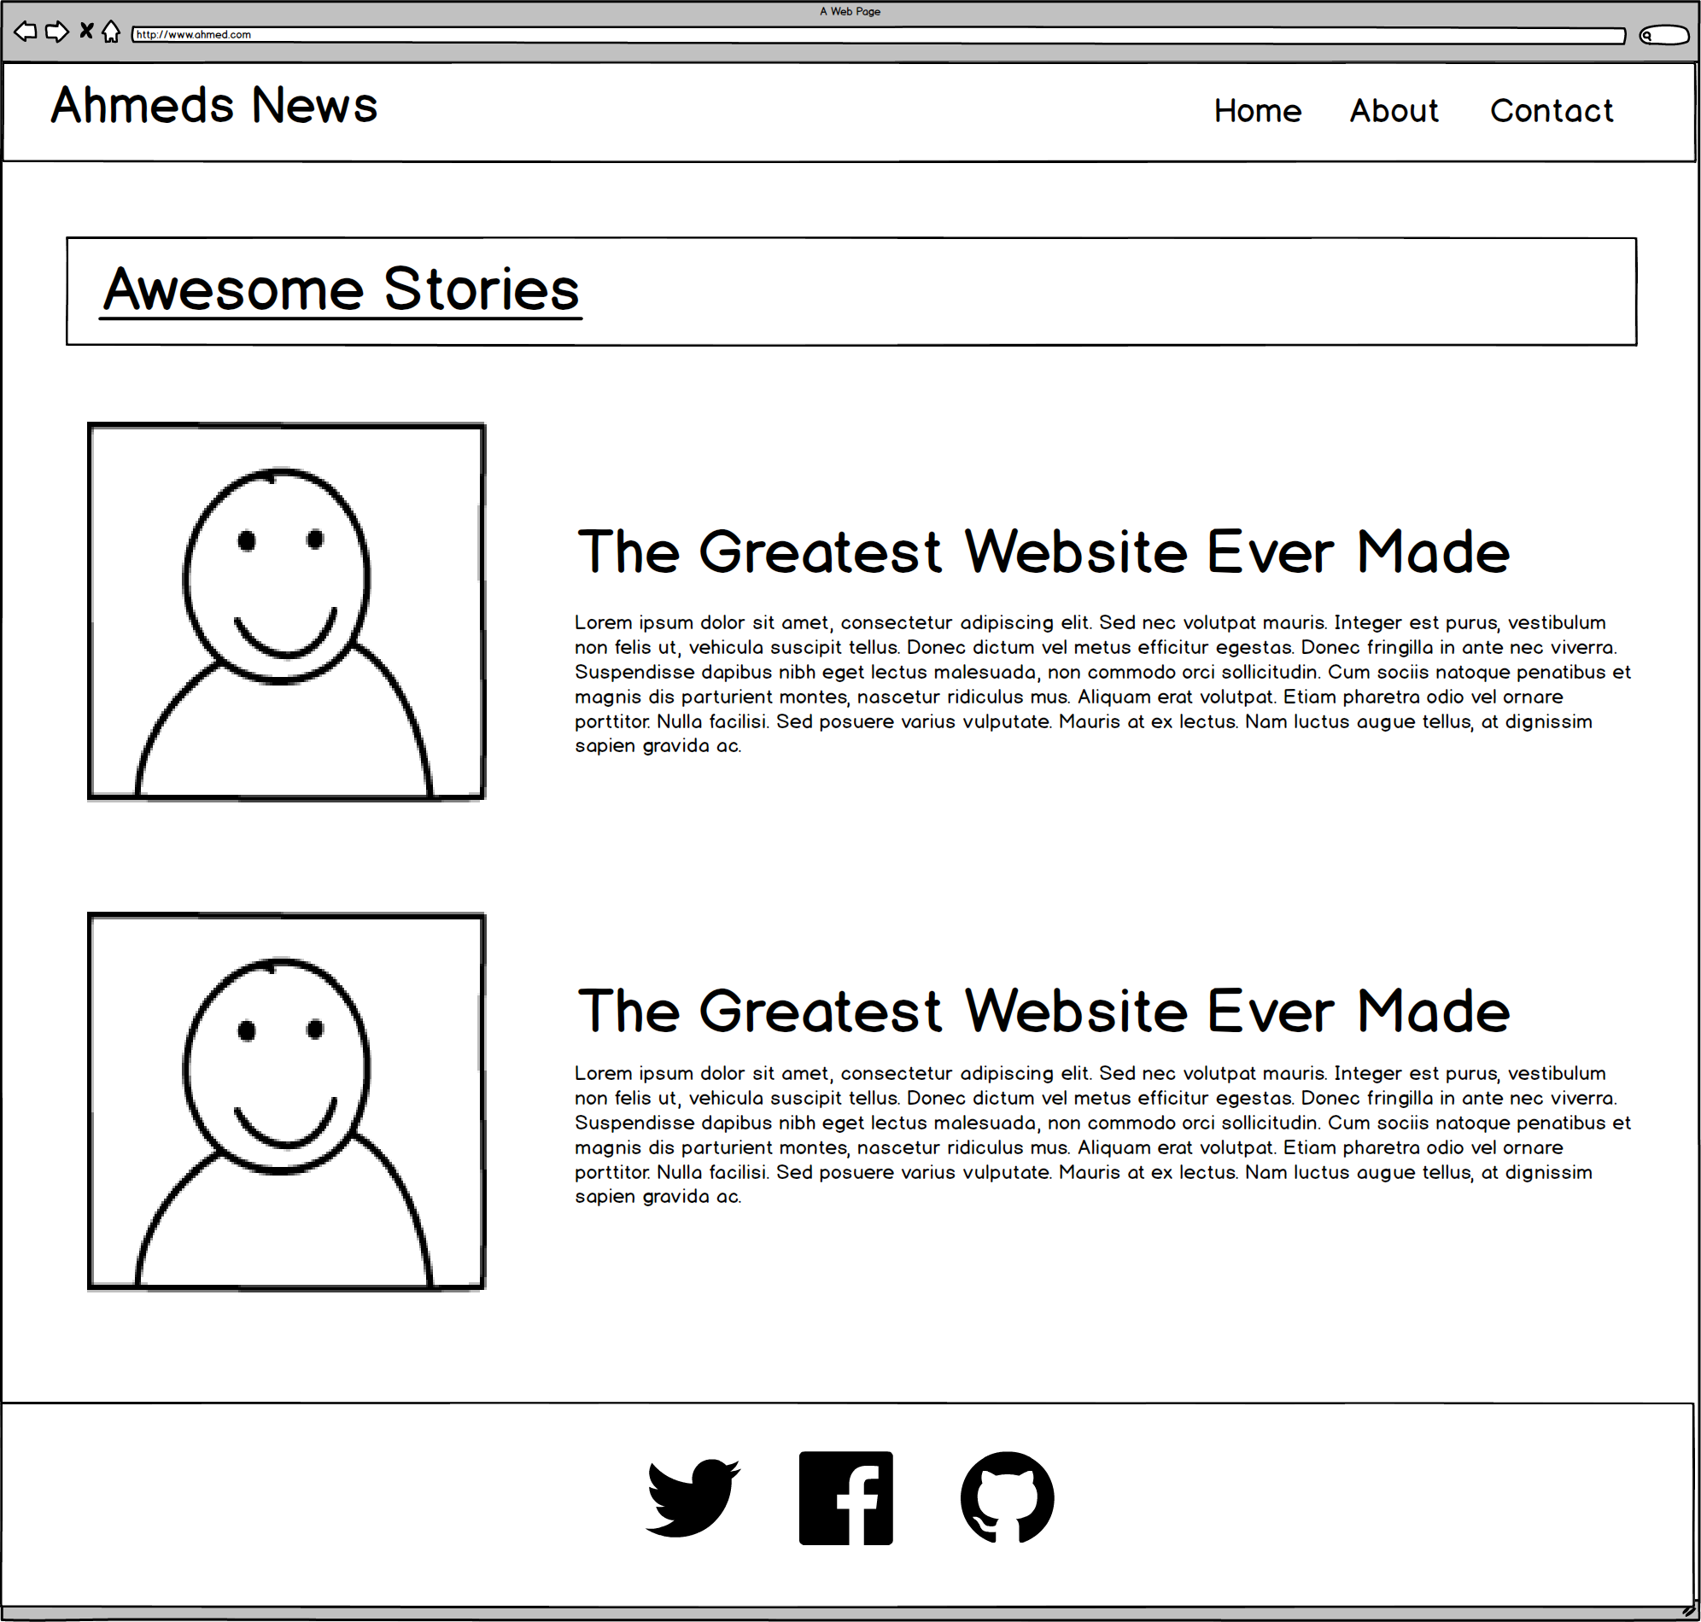
Notes:
7:00 – 7:05

Slide 61
ROWS
1
1
1
3 Total
Notes:
7:00 – 7:05

Slide 62
COLUMNS
1
2
2
1
Total Not relevant
Notes:
7:00 – 7:05

Slide 63
Level Up
Now, for another…
© 2016 | RCB - All Rights Reserved
© 2016 | Rutgers Coding Bootcamp - All Rights Reserved

Slide 64
Notes:
7:00 – 7:05

Slide 65
ROWS
1
1****
1
4
Total
1
Notes:
7:00 – 7:05

Slide 66
COLUMNS
1
3
1
1
Total Not relevant
Notes:
7:00 – 7:05

Slide 67
Notes:
7:00 – 7:05

Slide 68
Level Up
This final one is tricky…
© 2016 | RCB - All Rights Reserved
© 2016 | Rutgers Coding Bootcamp - All Rights Reserved

Slide 69

Notes:
7:00 – 7:05

Slide 70
Level Up
Didn’t quite work right?
For this one we need sub-rows and sub-columns
© 2016 | RCB - All Rights Reserved
© 2016 | Rutgers Coding Bootcamp - All Rights Reserved

Slide 71
ROWS
1
1
1
4
Total
1
Notes:
7:00 – 7:05

Slide 72
COLUMNS
1
2
1
Total Not relevant
Notes:
7:00 – 7:05

Slide 73
SUB-
ROWS
1
1
1
1
1
1
Total
4
Total
Notes:
7:00 – 7:05

Slide 74
SUB-
COLUMNS
2
1
1
Notes:
7:00 – 7:05

Slide 75
Notes:
7:00 – 7:05

Slide 76
Level Up
Ahmed’s Example App
https://mean-google-maps.herokuapp.com/
© 2016 | RCB - All Rights Reserved
© 2016 | Rutgers Coding Bootcamp - All Rights Reserved

Slide 77
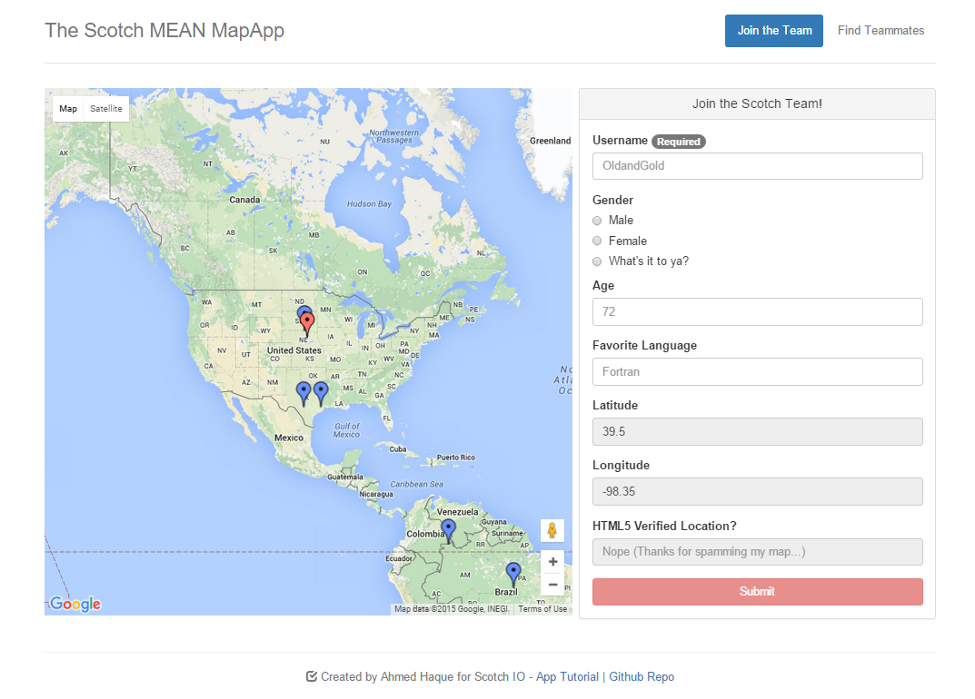
Notes:
7:00 – 7:05

Slide 78
ROWS
1
1
Notes:
7:00 – 7:05

Slide 79
COLUMNS
2
1
Notes:
7:00 – 7:05

Slide 80

Notes:
7:00 – 7:05

Slide 81
Break!
© 2016 | RCB - All Rights Reserved
Notes:
7:00 – 7:05

Slide 82
Grid Designs with Bootstrap
© 2016 | RCB - All Rights Reserved
Notes:
7:00 – 7:05

Slide 83

Take a Facebook Break…
Warning!
This is a fairly “tricky”… but VERY IMPORTANT topic.
Time to channel that inner genius.
© 2016 | RCB - All Rights Reserved
Notes:
7:00 – 7:05

Slide 84
Notes:
7:00 – 7:05

Slide 85
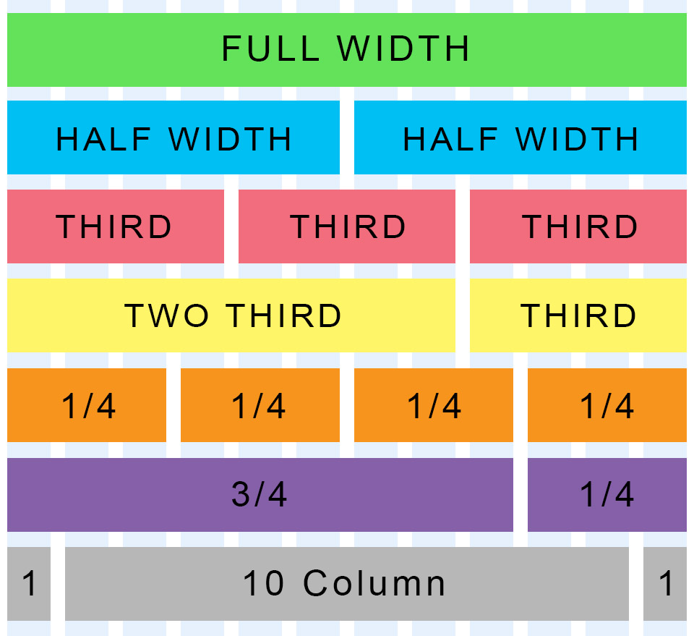
Bootstrap Grid
Bootstrap lets you organize content based on the “number of columns” a div spans – out of a total 12 columns.
Example:
<div class="col-md-12">
(Spans full width)
<div class="col-md-4">
(Spans 1/3 of full width)
© 2016 | RCB - All Rights Reserved
© 2016 | Rutgers Coding Bootcamp - All Rights Reserved

Slide 86
Bootstrap Grid
Every Bootstrap Grids is made up of…
containers - which wrap around the entire grid)
rows - which are defined first and are just rows)
columns - which are defined within rows and specify the columns. The sum total of all columns within a row must add up to 12.
Columns are inside of rows, not vice versa (impt!)
Each of these elements is implemented by creating a div with a specific class name.
© 2016 | RCB - All Rights Reserved
© 2016 | Rutgers Coding Bootcamp - All Rights Reserved

Slide 87

Bootstrap Grid
Note the rows, columns (col-lg-6), and containers
© 2016 | RCB - All Rights Reserved
© 2016 | Rutgers Coding Bootcamp - All Rights Reserved

Slide 88

Bootstrap Grid
© 2016 | RCB - All Rights Reserved
© 2016 | Rutgers Coding Bootcamp - All Rights Reserved

Slide 89

Defining Containers
“Containers” are like the box that the entire grid sits inside.
© 2016 | RCB - All Rights Reserved
© 2016 | Rutgers Coding Bootcamp - All Rights Reserved

Slide 90

Defining Rows
“Rows” are like the rows we talked about earlier.
© 2016 | RCB - All Rights Reserved
© 2016 | Rutgers Coding Bootcamp - All Rights Reserved

Slide 91

Defining Columns
“Columns” fit inside of rows. Note the syntax: col-sz-#
Col = column
sz = viewing size (in this case: medium)
# = number of “columns taken” out of 12. (in this case 4 of 12)
© 2016 | RCB - All Rights Reserved
© 2016 | Rutgers Coding Bootcamp - All Rights Reserved

Slide 92
> YOUR TURN!!
5 min
Quick Activity:
Turn to your neighbors and explain to one another:
The relationship between containers, rows, and columns. (Draw it on a piece of paper for them)
The syntax for each.
The specific syntax details for columns.
© 2016 | RCB - All Rights Reserved
Notes:
Send snapshot from Git command line

Slide 93
> YOUR TURN!!
15 min
Activity:
Using Twitter bootstrap, create a layout that looks like the one shown on the next screen.
Spend some time prior to coding to draw out the grid layout
Count the number of rows and columns
Then use the bootstrap grid syntax to code it out.
Slack a screenshot of your page when you are done.
© 2016 | RCB - All Rights Reserved
Notes:
Send snapshot from Git command line

Slide 94

> YOUR TURN!!
© 2016 | RCB - All Rights Reserved
© 2016 | Rutgers Coding Bootcamp - All Rights Reserved

Slide 95
Layout Building with Bootstrap
© 2016 | RCB - All Rights Reserved
Notes:
7:00 – 7:05

Slide 96
Notes:
7:00 – 7:05

Slide 97
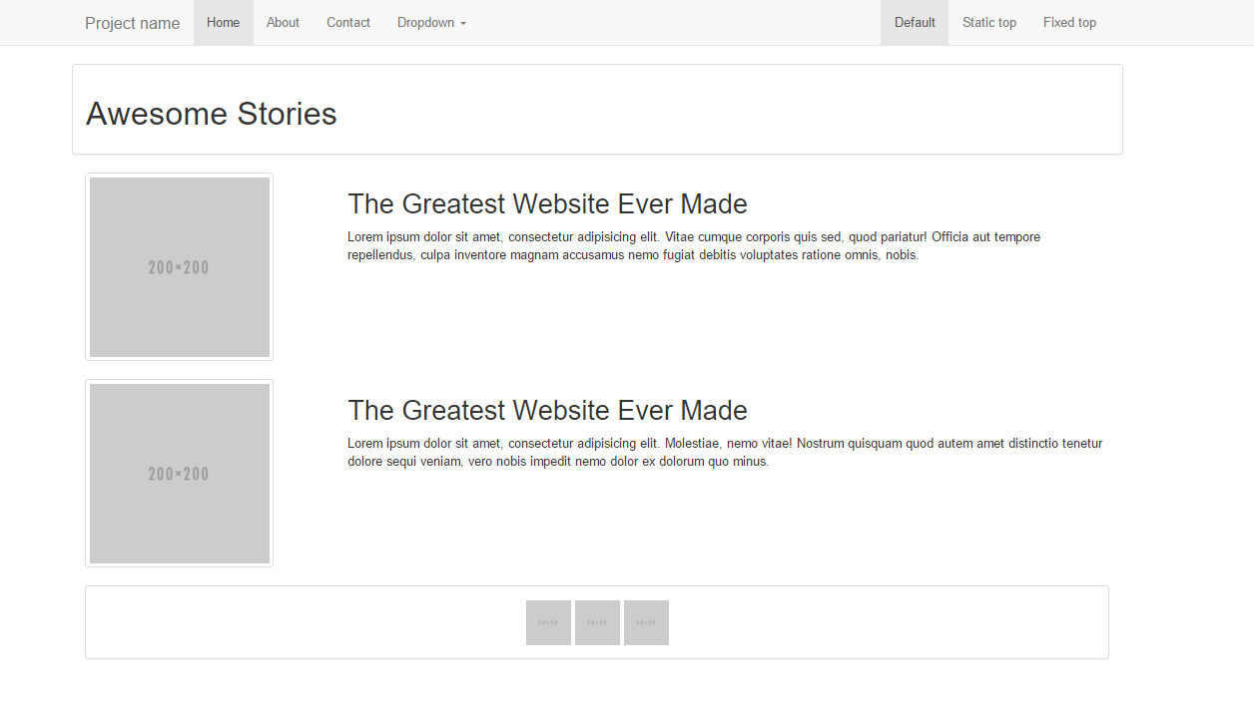
Notes:
7:00 – 7:05

Slide 98
> YOUR TURN!!
20 min
Activity:
Using Twitter Bootstrap make the following design.
Be sure to note the:
Grid Layout
Navbar
Sidebar panel
Thumbnail
Additional details will be sent to you via slack.
© 2016 | RCB - All Rights Reserved
Notes:
Send snapshot from Git command line

Slide 99
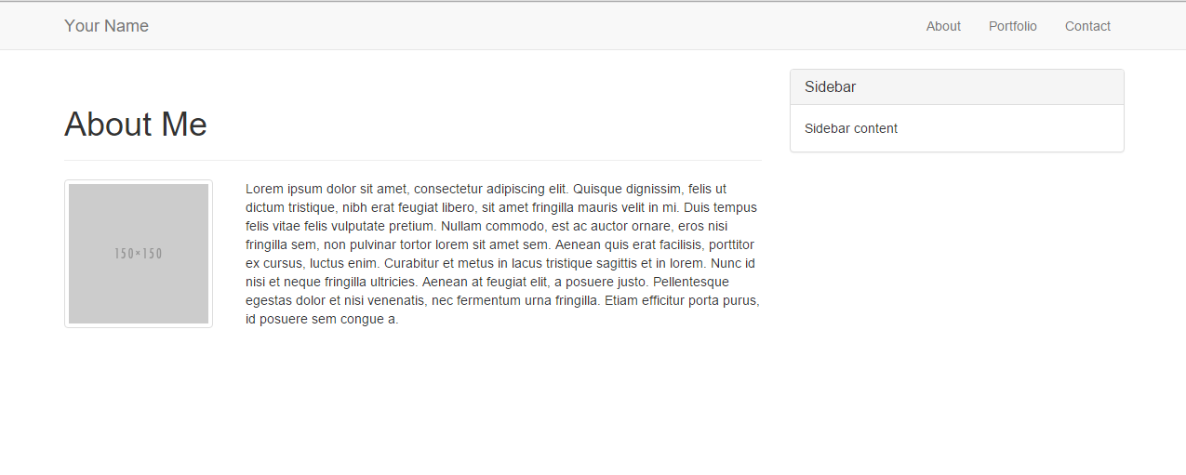
> YOUR TURN!!
3min
© 2016 | RCB - All Rights Reserved
Notes:
Send snapshot from Git command line

Slide 100
Is this you yet?
© 2016 | RCB - All Rights Reserved
© 2016 | Rutgers Coding Bootcamp - All Rights Reserved

Slide 101
Going Mobile Responsive (HW)
© 2016 | RCB - All Rights Reserved
Notes:
7:00 – 7:05

Slide 102

Take a Facebook Break…
Warning!
This next section matters a lot for your homework
© 2016 | RCB - All Rights Reserved
Notes:
7:00 – 7:05

Slide 103
Media Queries
Media Queries define how CSS styles are applied in relation to the characteristics of the viewing device.
Through media queries we can change the way a webpage is displayed based on width, height, orientation, and even resolution.
Bootstrap extensively uses media queries to help you create mobile responsive websites.
But remember! Media queries must be declared last.
© 2016 | RCB - All Rights Reserved
© 2016 | Rutgers Coding Bootcamp - All Rights Reserved

Slide 104
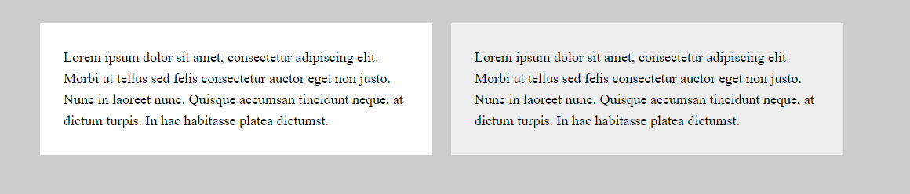
Quick Demo
© 2016 | RCB - All Rights Reserved
© 2016 | Rutgers Coding Bootcamp - All Rights Reserved

Slide 105
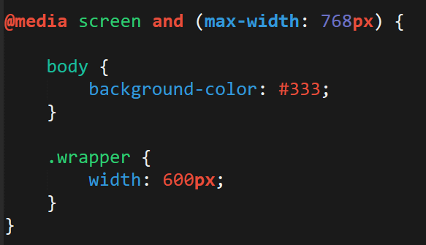
> YOUR TURN!!
5 min
Activity:
Explain to your partner what the following CSS code does:
© 2016 | RCB - All Rights Reserved
Notes:
Send snapshot from Git command line

Slide 106
> YOUR TURN!!
20 min
Activity:
Build your own mobile responsive HTML /CSS page using media queries.
Just following the steps sent to you via Slack.
© 2016 | RCB - All Rights Reserved
Notes:
Send snapshot from Git command line

Slide 107
Viewport
Viewport is the user’s visible area of a webpage.
Viewport controls how a webpage is displayed on a mobile device. Without this, mobile devices would render the page at a typical desktop screen (scaled down).
© 2016 | RCB - All Rights Reserved
© 2016 | Rutgers Coding Bootcamp - All Rights Reserved

Slide 108


Viewport
No Viewport
Yes Viewport
© 2016 | RCB - All Rights Reserved
© 2016 | Rutgers Coding Bootcamp - All Rights Reserved

Slide 109
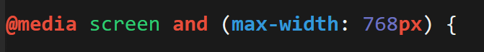
Viewport Inclusino
Just include this line in the head
And then include a variety of @media queries for various sized screens.
© 2016 | RCB - All Rights Reserved
© 2016 | Rutgers Coding Bootcamp - All Rights Reserved

Slide 110
> YOUR TURN!!
15 min
Activity:
Using the HTML / CSS document that you just created, utilize the viewport tag and new media queries to make your page more mobile responsive.
Additional details sent via slack.
© 2016 | RCB - All Rights Reserved
Notes:
Send snapshot from Git command line

Slide 111
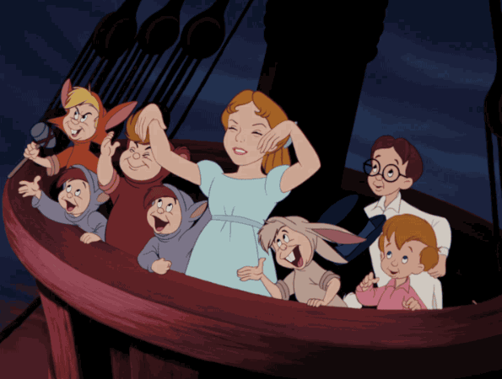
© 2016 | RCB - All Rights Reserved
Notes:
Send snapshot from Git command line

Slide 112
Questions?
© 2016 | RCB - All Rights Reserved
Notes:
7:00 – 7:05

